Slide 1
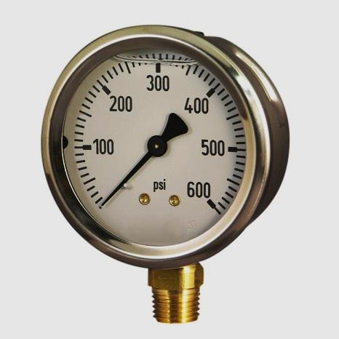
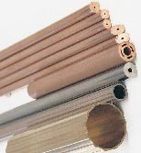
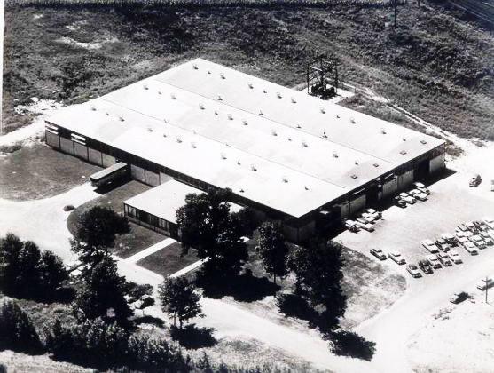
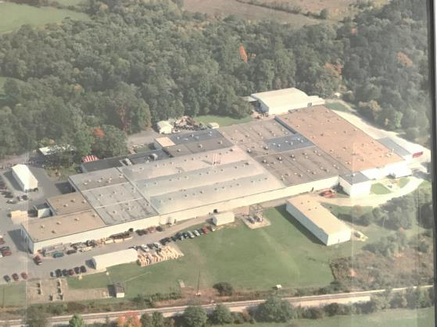
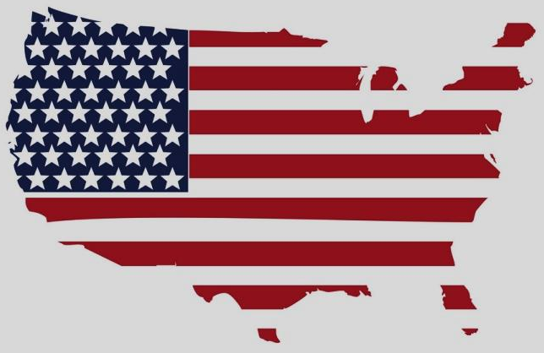
Welcome to small tube products Duncansville, PA U.S.A.
Skilled Producers of Copper and Brass Tubing
Continuing the Excellence Established in 1947

Slide 2
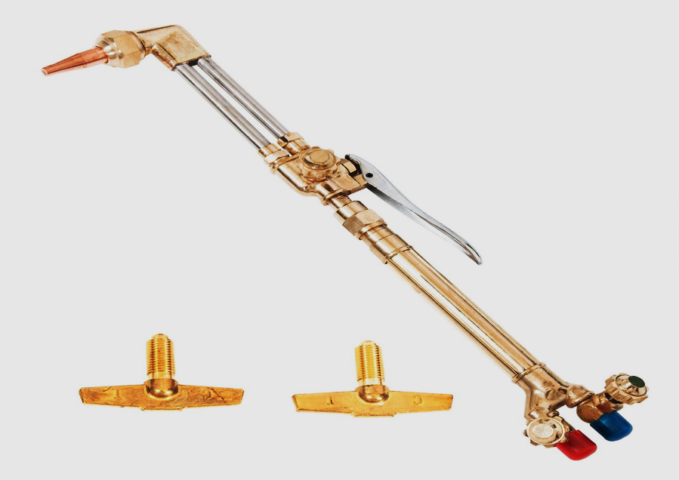
Contents
STP’s Role in the Supply Chain
Statistics / Capabilities
STP Core Competencies
Served Markets
Alloys and Tube Sizes
Tooling
Markets Served
Packaging Forms
Shapes / Fabrication Department
Plant Layout
Notes:
The presentation outline, what will be covered

Slide 3
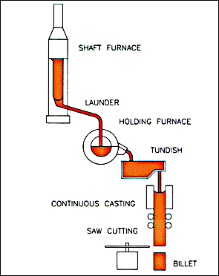
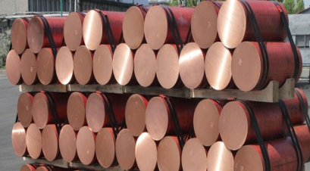
STP’s Role in the Supply Chain
Cast and Extrusion
STP’s
Operations

Slide 4
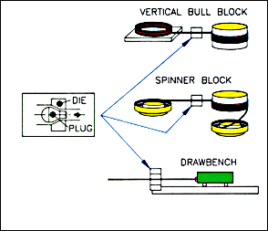
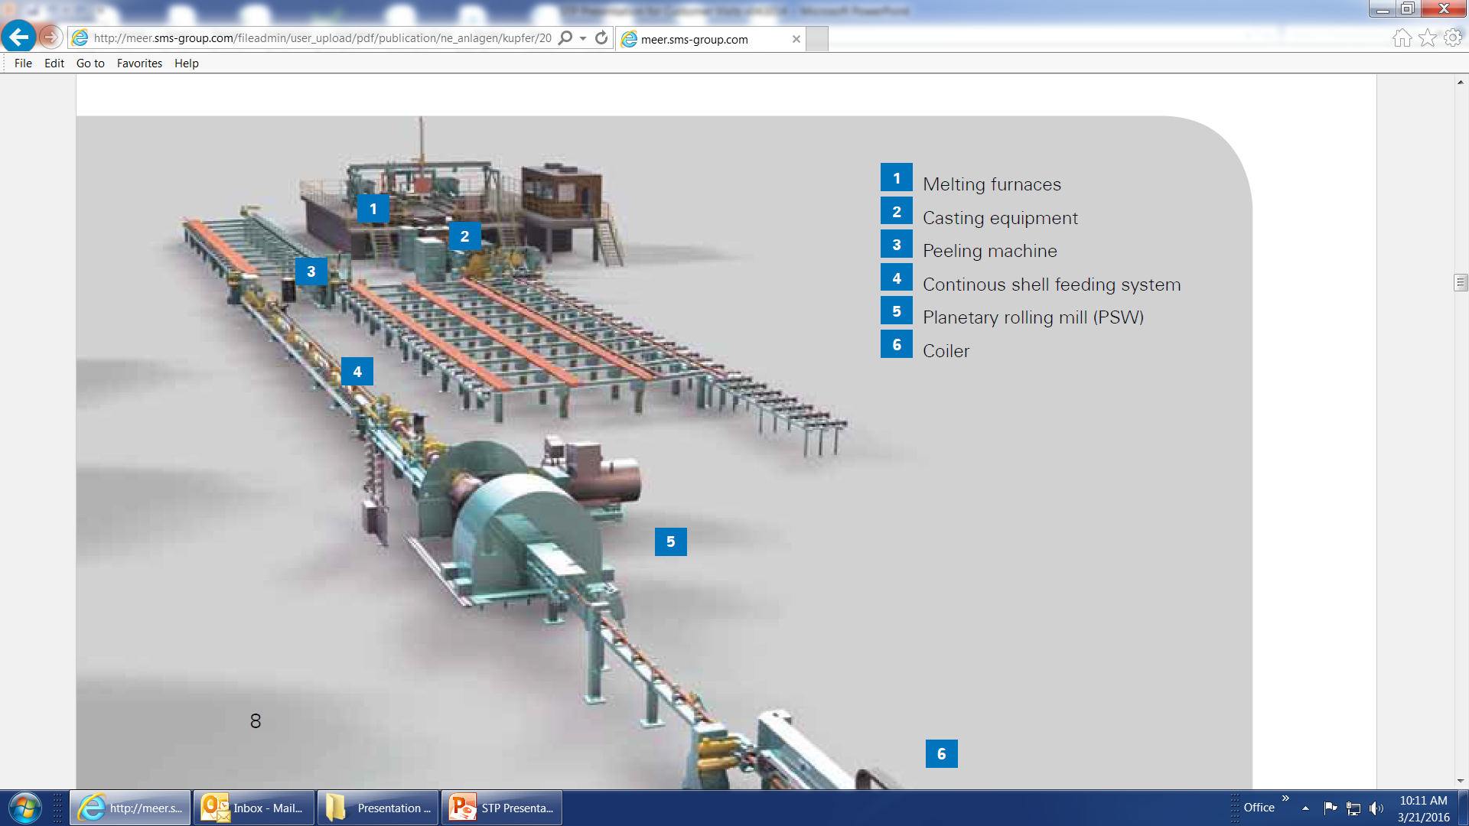
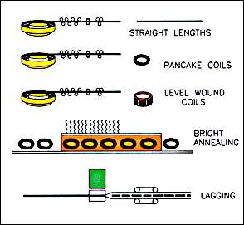
STP’s Role in the Supply Chain
Cast and Roll Technology

Slide 5
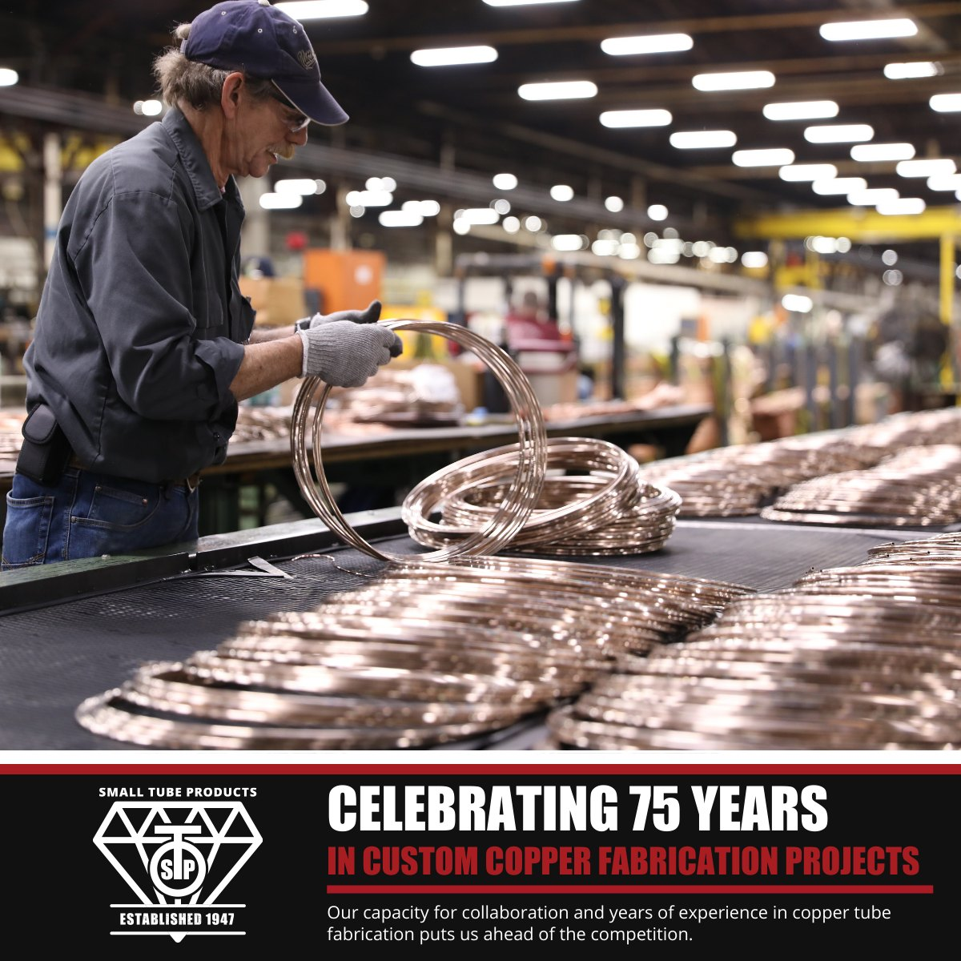
Our People
180 Employees
Experienced workforce w/ 16 years avg. service
Dedicated to craftsmanship

Slide 6
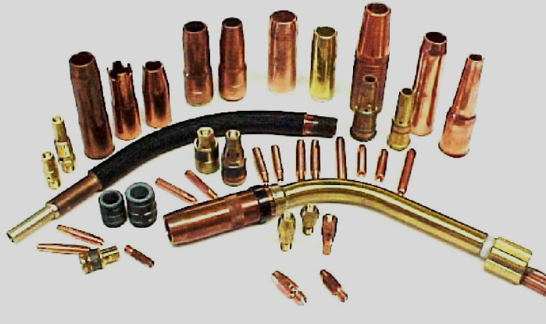
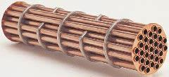
Plant Data / Capabilities
Plant Information:
210,000 sq. ft.
3 shifts / 5 day weeks
ISO 17025 Accredited Laboratory
Dimensional
Mechanical -tensile, yield, elongation, hardness
Microstructural Analysis -grain
Residual Stress
Conductivity
Optical Emission Spectrometry (OES) - chemical analysis
On-site Customer Service:
Servicing customers’ needs at the production site
Gateway for customer to STP’s commercial and technical services
Quotation requirements
Order Processing / Special Requests

Slide 7
STP Core Competencies
Precision redrawing of metals
22 different copper alloys, 2 Aluminum alloys
Die profiling expertise
Precision straightening
Shapes (>1000 architectural combinations)
Short Cut-To-Length
Small lot sizes - 100 lb. minimum
ISO 9001 registered facility
Lean Enterprise Culture
Photos circa 1965

Slide 8
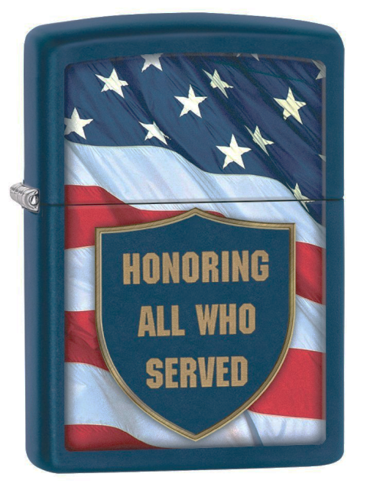
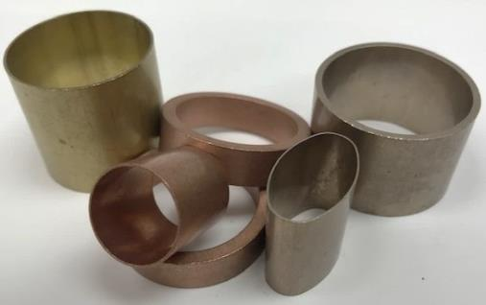
Large Selection of Alloys (listed by UNS Numbers)
Brasses
C22000
C23000
C26000
C27000
C33000
C33200
C43500
C44300
C68700 (special order)
Phos Bronze
C51000
C52100
Nickel Silver
C74000
C75200
Aluminum
A91100
A93003
Coppers
C10100
C10200
C12000
C12200
C14200 (special order)
C19400
Copper-Nickel
C70600
C71000 (special order)
C71500
Other Alloys may be available upon request
Precision cutting -0.125” to 42 foot lengths

Slide 9
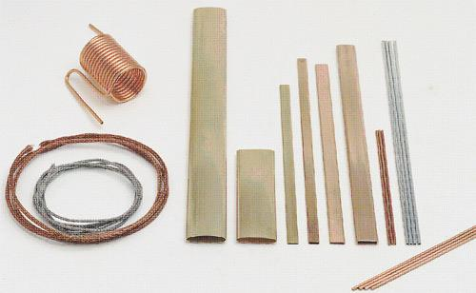
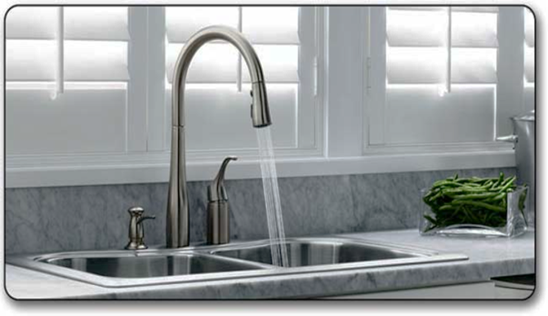
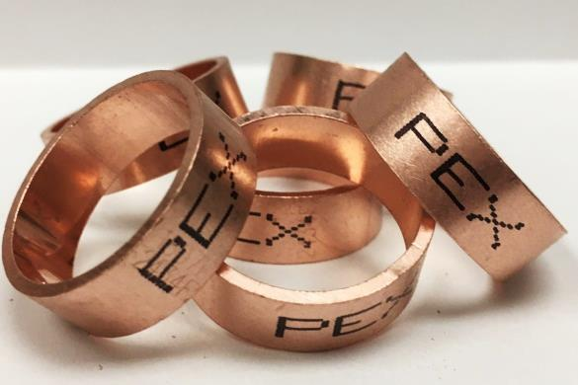
Tube Size Ranges
COILS --------------------------------------------------------------
ALLOY OD WALL THICKNESS
Copper .040" - .875" .005" - .200"
Brass .040" - .875" .010" - .065"
Copper Nickel .040" - .875" .010" - .070"
Aluminum .040" - .875" .012" - .065"
STRAIGHT LENGTHS -----------------------------
ALLOY OD WALL THICKNESS
Copper .040" - 2.625" .004" - .367"
Brass .125" - 2.625" .010" - .175"
Copper Nickel .125" - 2.625" .010" - .175"
Leaded Brass .109" - 1.375" .010" - .200"
Phos Bronze .200" - .875" .004" - .045"
Aluminum .040" - 2.000" .012" - .200"

Slide 10
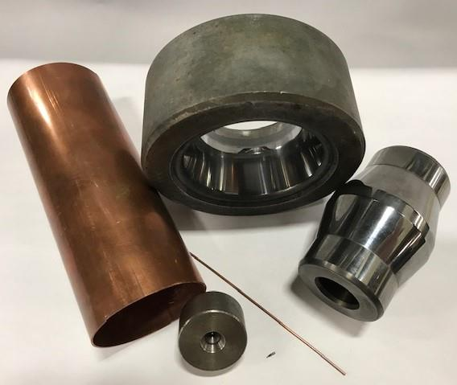
STP In-House Tooling
The essence of STP’s quality tubing:
Tooling expertise
In-house maintenance and engineering
Skilled manufacturing people and processes
Extensive training program for tool room personnel
Superior abilities with:
Die and plug profiling
Maintenance of Shape Tools
Saw blade sharpening
Gage maintenance and design
Problem Solving for drawing issues
Tube straightening
Short cut lengths
3-D Printing Technology
Largest Die/Plug
Smallest Die/Plug

Slide 11
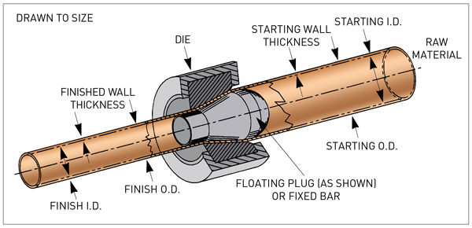
The Essence of Tube Drawing
How Cold Work is applied

Slide 12
STP Served Markets
WELDING
TRANSPORTATION
(Welding tips, torch handles)
(oil coolers, radiators, power steering, brake line)
18%
25%
CONTROLS
(gas valves, connectors, cap tube, bourdon tube)
2%
HEAT TRANSFER
(Marine cooling, industrial oil coolers, radiators)
17%
ELECTRICAL
(Electrical connectors, induction coils, coolant tube)
PLUMBING
20%
(PEX Rings,
Faucets)
6%
Diversified Customer Base
Over 880 Active Customers
Average Order Size > 1,400 Lbs.
6%
6%
OTHERS
CONSUMER PRODUCTS
(Coax cable, musical,
distributors, misc.)
(Lighter flint tube, HVAC, fabricators)
Notes:
Automotive Transmission oil cooler, radiators, power steering Long, Modine, Coupled Products
Electrical Connectors, induction coils, coolant tube Thomas& Betts, Panduit, Siemens Wx
Consumer Products Lighter case tube, refrigeration, fabricators Parker, Danfoss, Zippo, Carrier Transicold
Others Electronics (coax), musical, plumbing, recreational, distributor Mansfield Plumbing
Heat Transfer Marine cooling, oil coolers, locomotive radiators WTE, Young Touchstone, Rocore, Thermal Transfer
Controls Reversing valve bodies, cap tube, bourdon tube Ranco, White Rodgers, Alco, WIKA
Welding MIG tips, torch handles TWECO, Miller, Bernard, Lincoln Electric
Alternate Metals Titanium

Slide 13
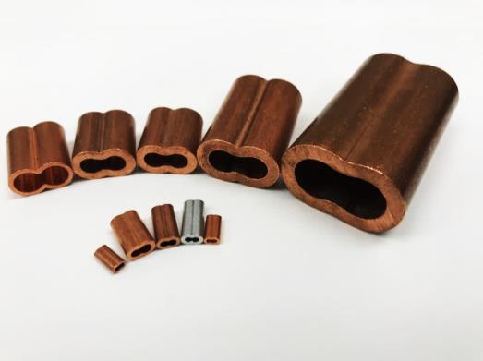
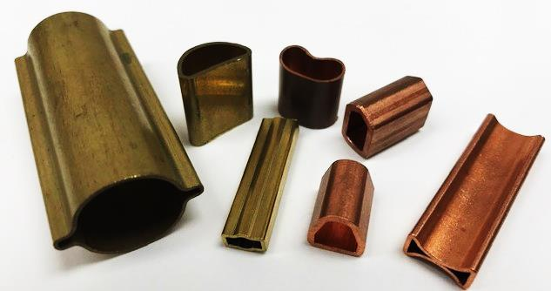
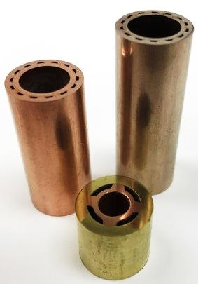
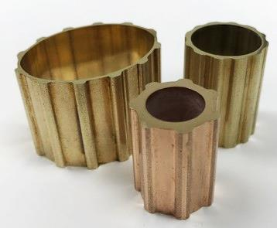
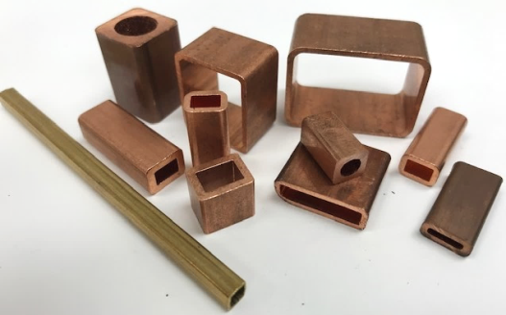
Examples of Shapes
Keyhole
D-Shape
Hourglass/Figure 8
B-Shape
Doghouse
Brushholder
Mailbox
Leak Detector Tube
I-Shape
More than 1,000 different shapes and sizes!
Oval-Shaped, Fluted OD
Square OD and ID
Square/Round
Duplex
Fluted OD/Round ID
Rectangle

Slide 14
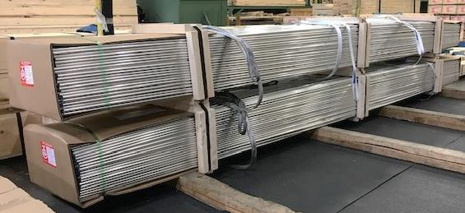
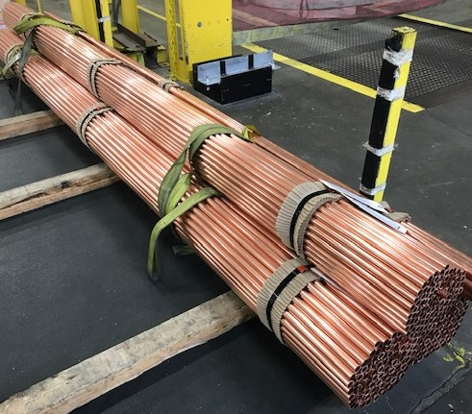
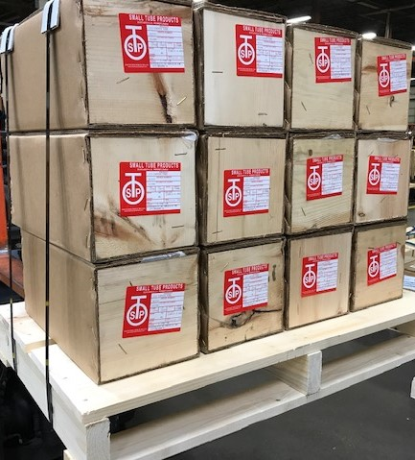
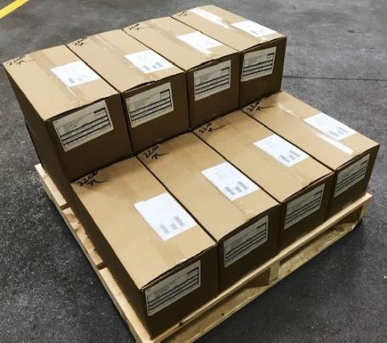
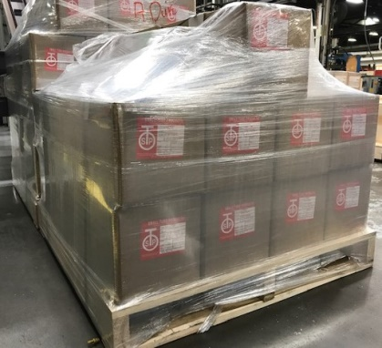
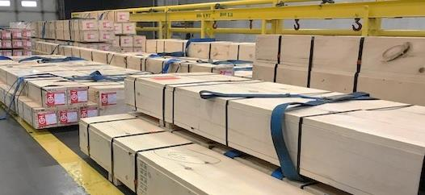
Straight Length Packaging
Wooden End Cardboard Boxes
Bundle Pack Options
All Cardboard Boxes
All Wood Boxes

Slide 15
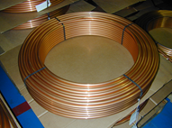
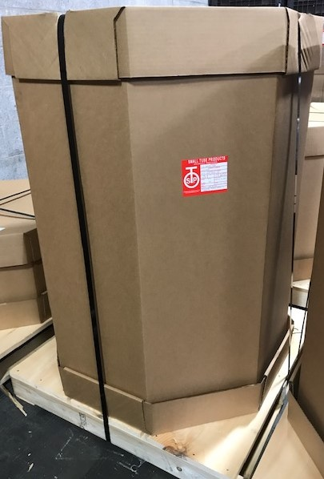
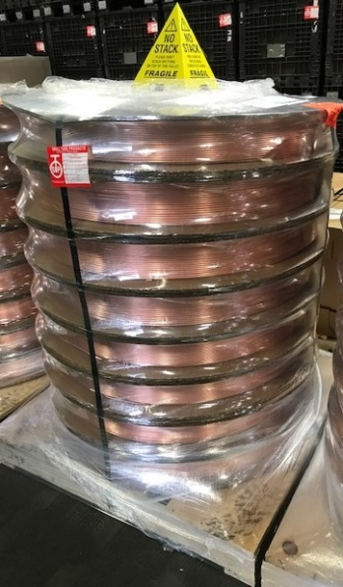
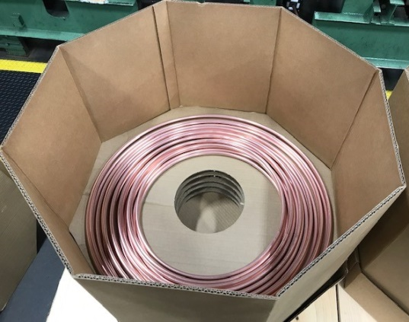
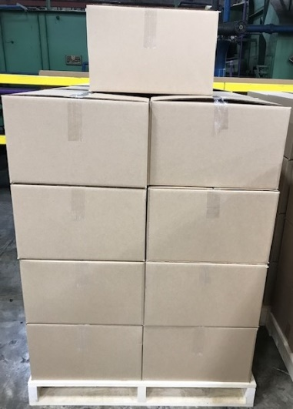
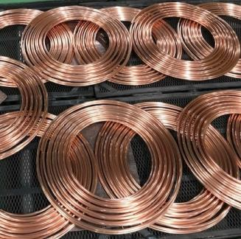
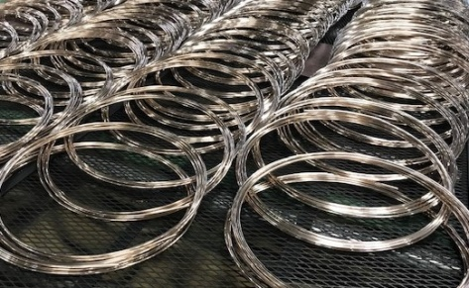
Coil Forms and Packaging
Bunch or Pancake Coils in Octagon-shaped cardboard box
Large Lavel Wound Coils packed in cardboard box or shrink wrapped
Smaller coil diameter bunch or pancake coils in square cardboard box

Slide 16
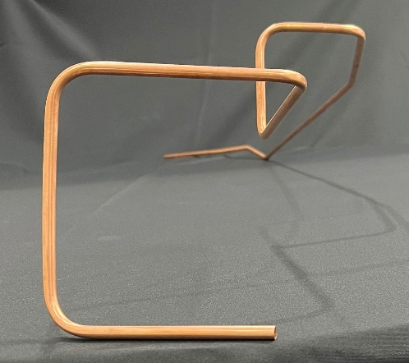
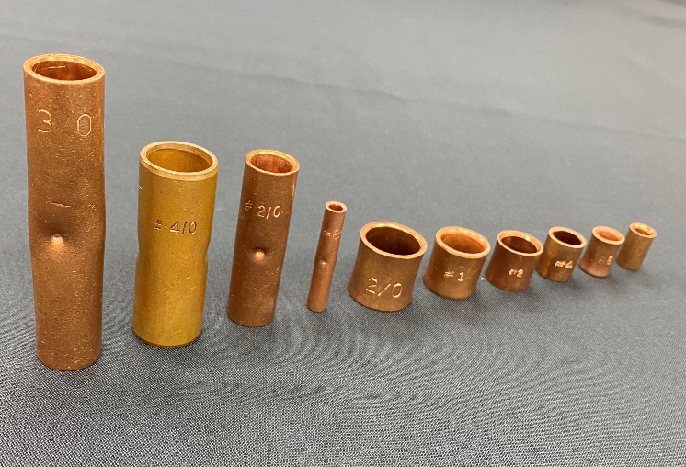
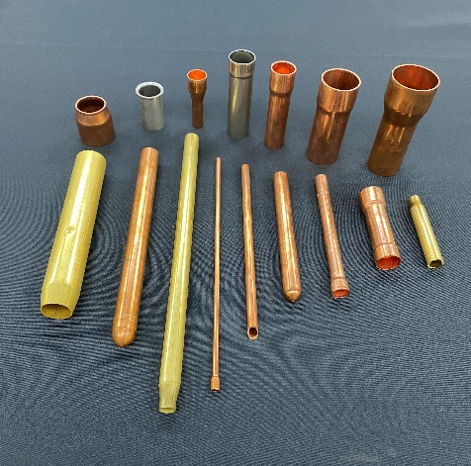
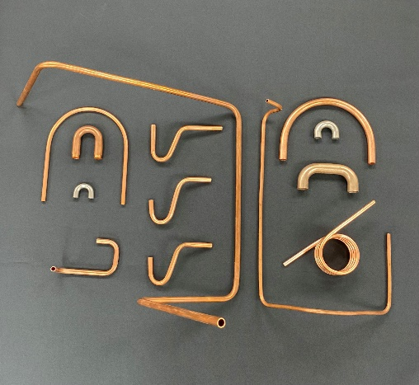
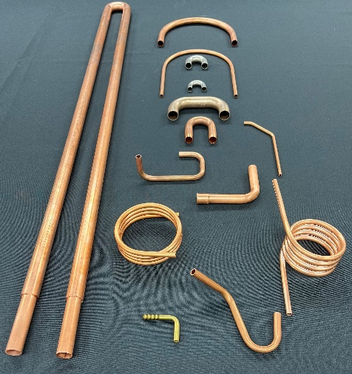
Tube Fabrication
All Copper Alloys, Brasses, Bronzes, Copper Nickels
Dedicated Fabrication New Product Development Engineer
Bending, Expanding, Swaging, Counterboring, Spinning, Incising, beading, special coiling, as well as other fabrications

Slide 17
Plant Floor Layout
Al Cell
Bench Department
Finishing Department
Pack & Ship
Cat Cell
Tools
Fab
Cell
TT Cell
Offices
X
Block Department
Notes:
17

Slide 18
Product Display

