Slide 1
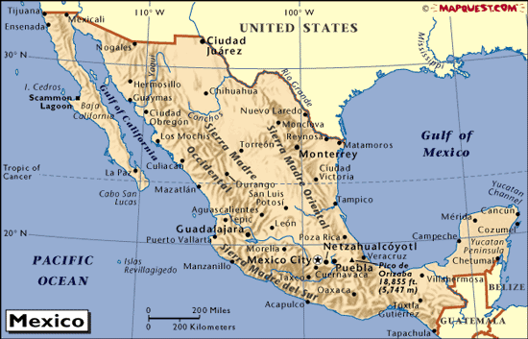
NA SALES REGIONS
WA
Salesman (11)
Tel.
@smalltubeproducts.com
MT
ND
ME
MN
Eastern CANADA
OR
VT
Call 814-695-4491
and ask for Sales
NH
ID
SD
WI
NY
MA
WY
Greg Priatko (25)
Tel. 262-441-0154
eaglemetal@earthlink.net
MI
RI
PA
CT
NV
NE
IA
NJ
UT
IL
IN
OH
DE
CA
CO
WV
VA
MD
KS
MO
KY
TN
NC
AZ
NM
OK
AR
Katherine Turkalo
Tel. 865-385-9944
Katherine.turkalo@gmail.com
SC
MS
AL
GA
TX
LA
FL
Juan Manuel Gutiérrez (18) (MEXICO/Border States)
Tel. 52-81-1279-2542
jgutierrez@guther.me
Effective 5/1/2023

